Slide 1
Integrated Health Care app
S. Kirankumar_20201CST0094
C. Nithish kumar_20201CST0125
G. Santhosh reddy_20201CST0143
M. Muni goutham_20201CST0156

Slide 2
Block Diagram
View Hospitals
View Doctors
Add Appointment
View Appointment status
View Healthcare Insurance
Register
user
View Appointments
View doctors
View user feedback
Call to doctor
payment
Database
Login
Hospital
Admin
Add Hospitals
View Hospitals
Add Healthcare Insurance
View user feedbacks
Doctor
View Appointments
Accept or Reject
Call with User

Slide 3
Class Diagram

Slide 4

UML diagrams use case

Slide 5
UML diagrams Sequence

Slide 6
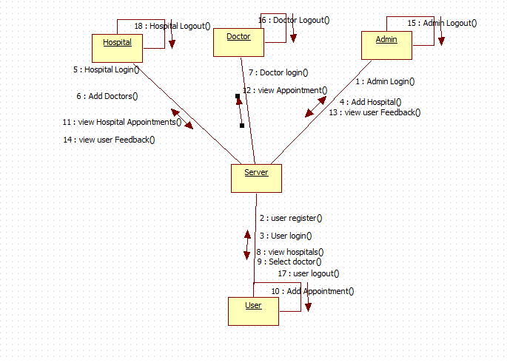
UML diagrams Collaboration

Slide 7
UML diagrams activity

Slide 8
UML diagrams Component

Slide 9
UML diagrams Deployment

Slide 10
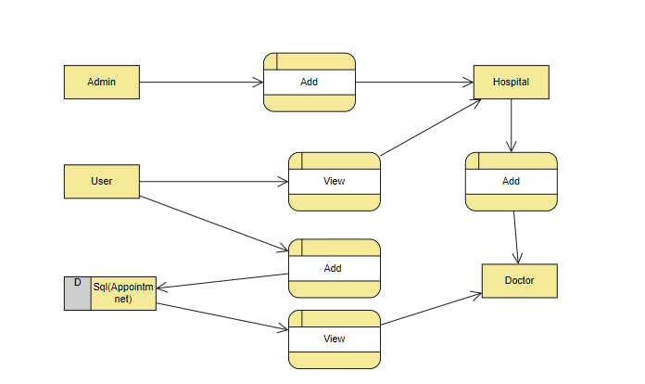
UML diagrams DFD

Slide 11
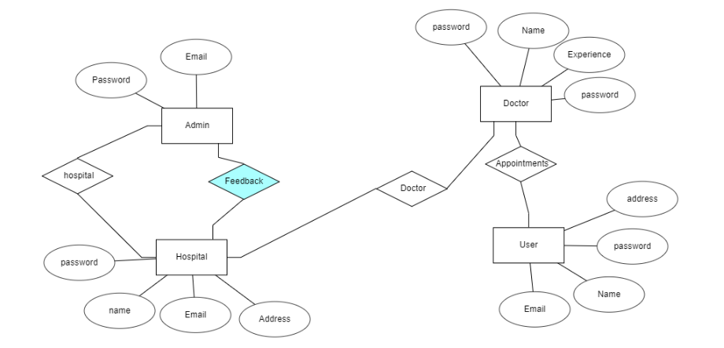
UML diagrams ER Diagram

Slide 12
THANK YOU!

